Slide 1
Health and Hospitals
Year 11
History

Slide 2
Industrial Revolution
During the Industrial Revolution there were huge advances made in science and technology.
Huge progress was made in identifying and preventing many diseases. People felt that humankind was becoming god-like in its knowledge and achievements, and that nothing was impossible except the cure of infectious disease - a problem that continued to cause much misery.

Slide 3
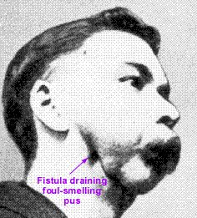
With the advent of industry came industrial diseases such as dermatitis, lung disease and ‘phossy jaw’. (ugh!)
Those most quickly affected were the workers who dipped sticks into phosphorus paste.

Slide 4
With the expansion of the Empire came contact with diseases such as yellow fever.
With urbanisation came public health problems that included 'filth diseases' such as cholera and typhus.

Slide 5
By the way…
The real ‘Medical Revolution’ started in France.
After the French Revolution the right to health was one of the 'rights of man' claimed by working people.

Slide 6
War
Wars were waged on a greater scale (creating mass injuries that were hitherto unknown, and required new medical and surgical techniques).
Who could do the quickest amputation without anaesthetic?!

Slide 7
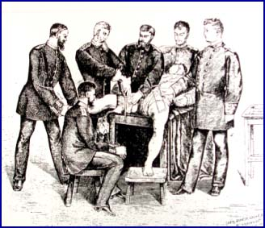

Slide 8
Hospitals
With the rapid growth of the population during the 18th and 19th centuries it was obvious that local charities and the workhouse system could not provide sufficient medical care for the poor.

Slide 9
Westminster Hospital
Founded as a voluntary hospital in a small house in Petty France, Pimlico, with just 10 beds in 1719. It occupied other sites, including one opposite Westminster Abbey and another in Page Street
Westminster Hospital in London, constructed in 1720, was the first public hospital in England.

Slide 10
‘It may seem a strange principle to enunciate as the very first requirement in a hospital that it should do the sick no harm. It is quite necessary nevertheless to lay down such a principle, because the actual mortality in hospitals, especially those the crowded cities, is very much higher than any calculation founded on the mortality of the same class of patient treated out of hospital would lead us to expect.' Florence Nightingale Notes on Hospitals 1859

Slide 11
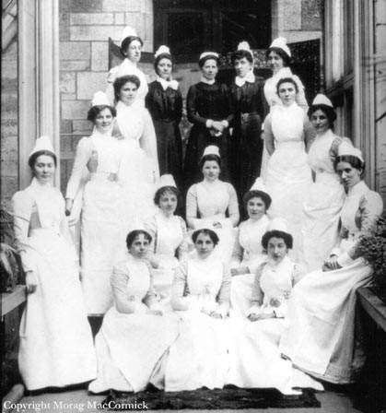
Nineteenth Century Nursing

Slide 12
By 1800, all sizeable British towns had a hospital, and London's hospitals admitted over 20,000 patients a year. Out-patient departments were even busier. In 1800, St Thomas's Hospital estimated that its out-patient department dealt with 10,000 patients. By 1890, the number was 100,000.

Slide 13
Voluntary hospitals generally admitted the sick poor but not sick paupers. Following the Poor Law Act (1834), there was increasing realisation that most of those admitted to workhouses were sick or elderly, and that sickness was the fastest route to pauperism. Workhouse infirmaries were rapidly filled to capacity, and by the 1860s, hospitals were being erected alongside workhouses.

Slide 14
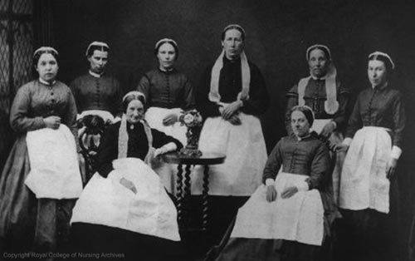

Slide 15
During the 18th century, the wealthy had largely been treated at home by private doctors but from the mid-19th century, some were choosing hospital admission. This resulted in loss of income for a number of doctors so that it became advantageous to secure an honorary consultancy post at a local hospital as well as maintaining a private practice.

Slide 16
Hospital consultants became the doctors of choice for rich patients. In addition, beds were set aside in voluntary hospitals for paying patients, and a number of small, private 'nursing homes' were established. These were effectively private hospitals for the middle classes. At the same time, some general practitioners began to establish their own 'cottage' hospitals.

Slide 17
During the first half of the century, nursing the sick was generally not believed to require any special training or experience. In the voluntary hospitals, convalescent patients were often called upon to help with acutely ill patients. In the workhouse infirmaries, able-bodied paupers nursed the sick.

Slide 18
In 1866, there were only 111 paid nurses in all the London workhouses and they earned £12-£30 a year. Mrs Isabella Beeton (1836-1865), who wrote her famous book of cookery and household management between 1859-1861, had been the head nurse at the Strand workhouse.

Slide 19
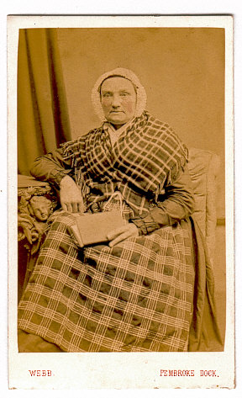
Ward sisters were often recruited from head servants in 'gentlemen's' households or were 'respectable' widows. Matrons, whose duties were largely administrative, were generally from middle-class backgrounds.

Slide 20
http://www.thegarret.org.uk/tour.htm
Click for virtual tour of a Victorian hospital.
Also provides useful links!

Slide 21
Florence Nightingale
Nursing was first popularized by Florence Nightingale; she portrayed it as a dignified and glamorous profession. Nightingale led the first women nurses, ten of them, into the Crimea, and afterwards, British society awarder her with enough funding to found a nursing school.

Slide 22
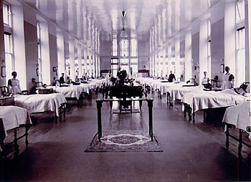

Slide 23
The traditional Nightingale ward of long straight corridors with wards radiating off at right angles and clustered around courtyards, was a legacy of the disastrous healthcare experience of British troops in the Crimea.

Slide 24
Nightingale had observed how soldiers who were taken into hospital invariably died, while those who were not treated there often survived. Crucially, she realised that many of the causes of death for recuperating soldiers could be designed out.

Slide 25
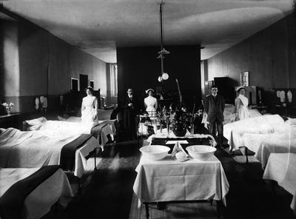
What she did was to lay down a set of dimensions to provide a safe place for patients, most importantly fresh air, warm food and an environment that was free of droplet infection.

Slide 26
Florence Nightingale was born on 12 May 1820
She had a broad education and came to dislike the lack of opportunity for females in her social circle. She began to visit the poor but became very interested in looking after those who were ill.

Slide 27
Crimean War
In March 1854 the Crimean War broke out and the reports of the sufferings of the sick and wounded in the English camps created anger in Britain. William Russell, The Times' correspondent, described the terrible neglect of the wounded, and pointed to the differences between the facilities provided for British and French soldiers. He asked: ‘Are there no devoted women among us, able and willing to go forth to minister to the sick and suffering soldiers of the East in the hospitals of Scutari?

Slide 28
Conditions
Descriptions from Nightingale and her nurses give some idea of the conditions there:
There were no vessels for water or utensils of any kind; no soap, towels, or clothes, no hospital clothes; the men lying in their uniforms, stiff with gore and covered with filth to a degree and of a kind no one could write about; their persons covered with vermin...

Slide 29
We have not seen a drop of milk, and the bread is extremely sour. The butter is most filthy; it is Irish butter in a state of decomposition; and the meat is more like moist leather than food. Potatoes we are waiting for, until they arrive from France...

Slide 30
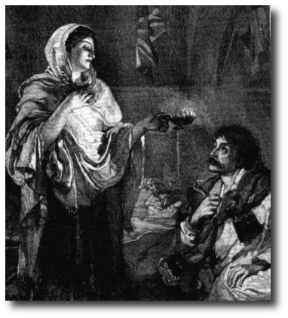
Grateful soldiers dubbed her 'The Lady With The Lamp' because of her nightly rounds of the wards.

Slide 31
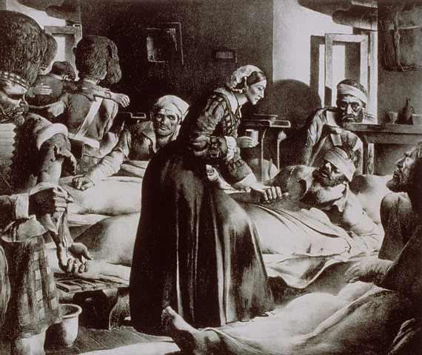

Slide 32
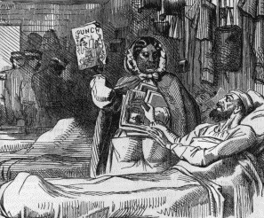
Homework
Research:
See what you can find out about
Mary Seacole.

Slide 33
This powerpoint was kindly donated to www.worldofteaching.com
http://www.worldofteaching.com is home to over a thousand powerpoints submitted by teachers. This is a completely free site and requires no registration. Please visit and I hope it will help in your teaching.

